Slide 1
Robots… Robots everywhere
…and they want to take my job
András SOMI KBC Equitas
11/23/2016

Slide 2
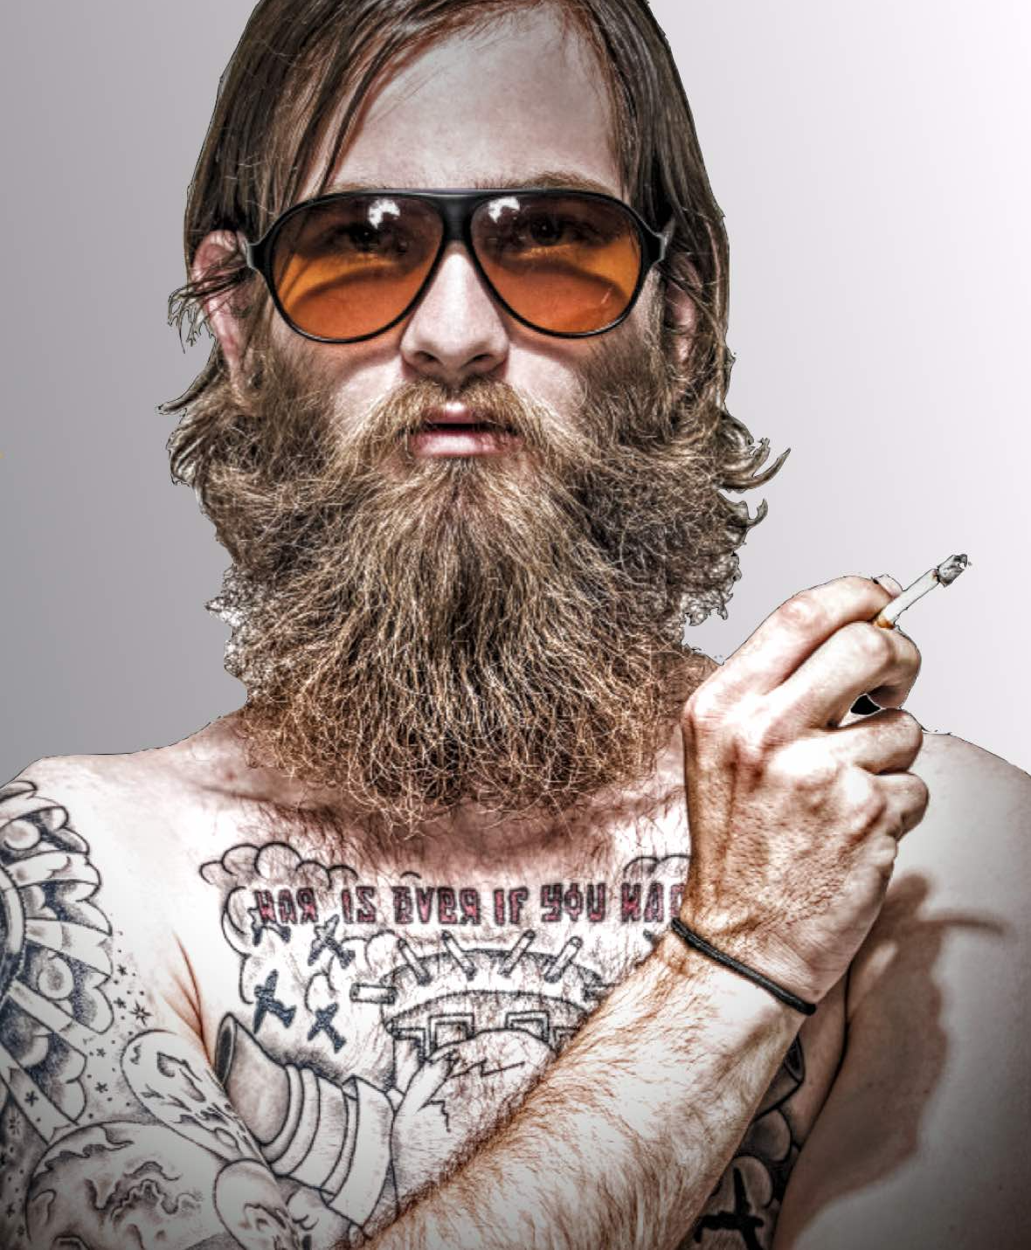

Slide 3
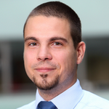
András SOMI
KBC Equitas
https://www.kbcequitas.hu
@somiandras
Dotkom
http://dotkomblog.com

Slide 4
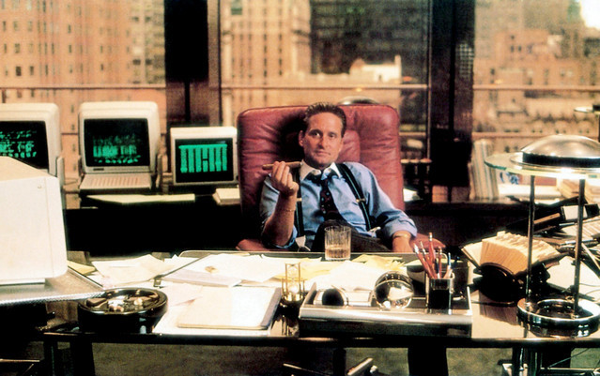

Slide 5
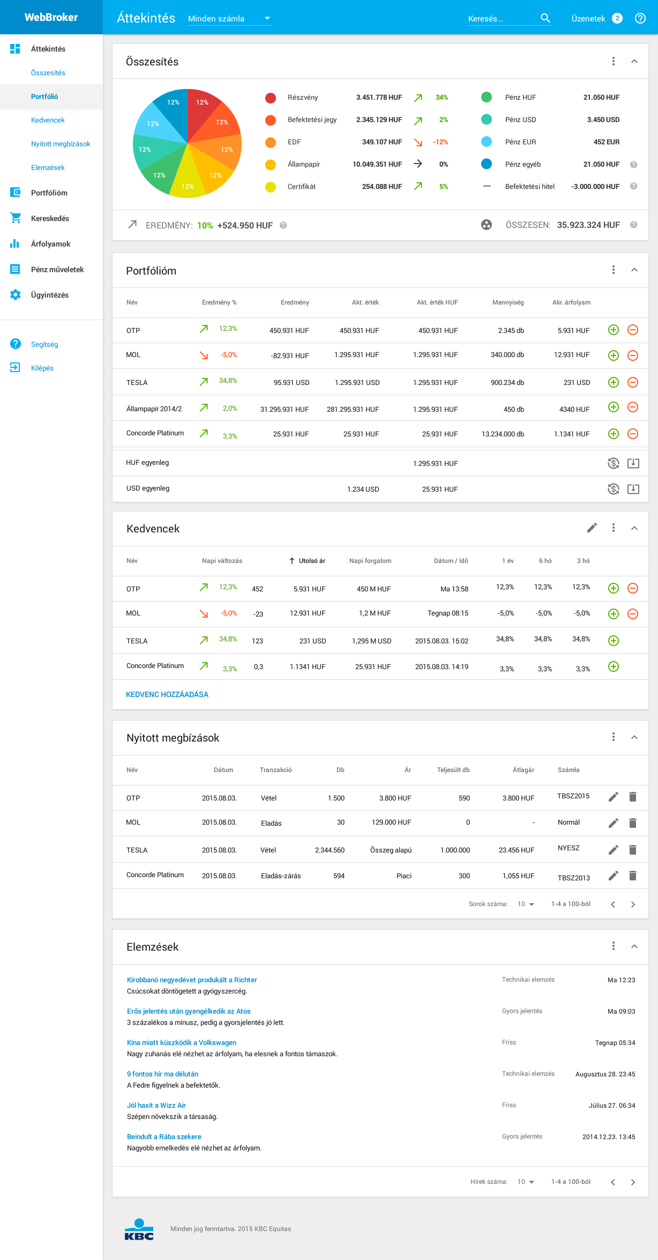
WebBroker

Slide 6
Complexity
Time horizon
Audience
Data volume
Digitalization

Slide 7
UI+AI+B

Slide 8
1.
Discovery

Slide 9
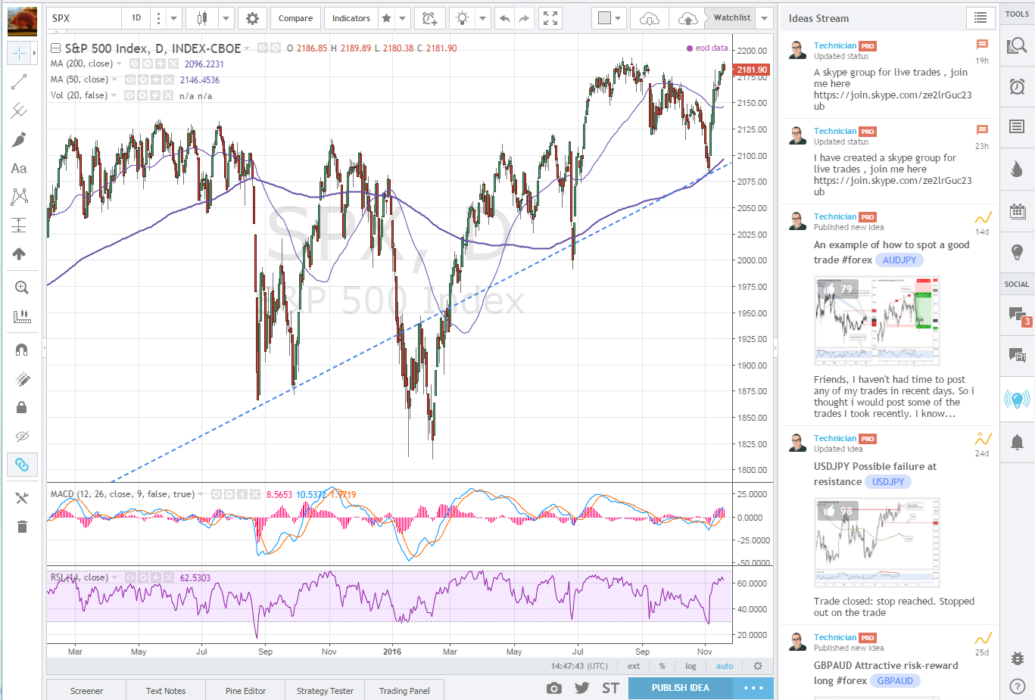
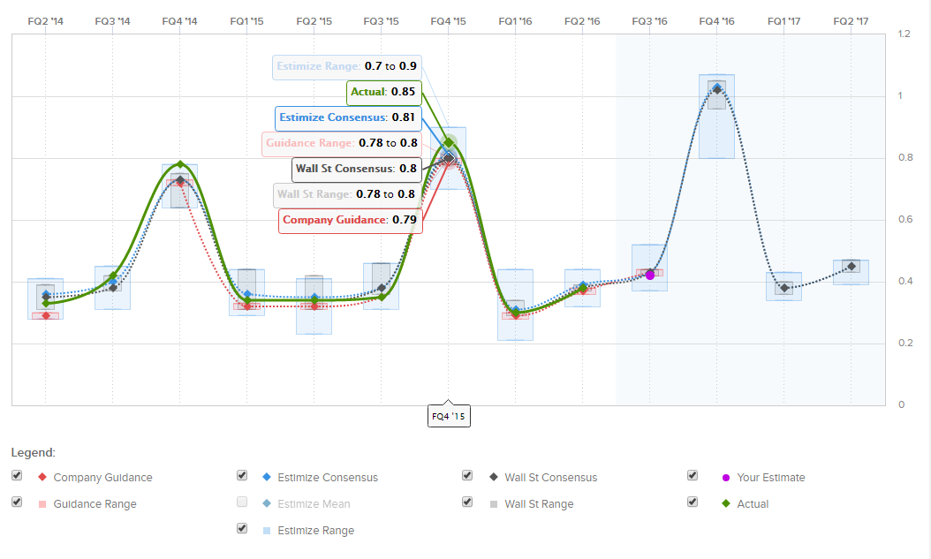
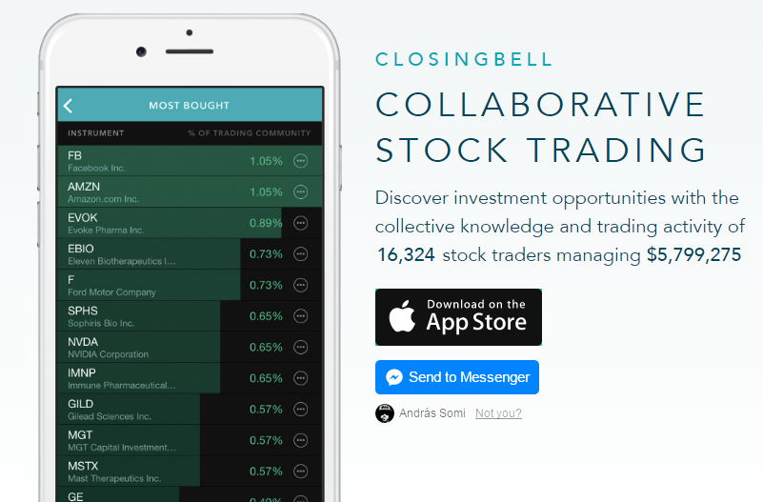
Tradingview
Estimize
Closingbell
and many more…

Slide 10
1.
Discovery
2.
Transactions

Slide 11
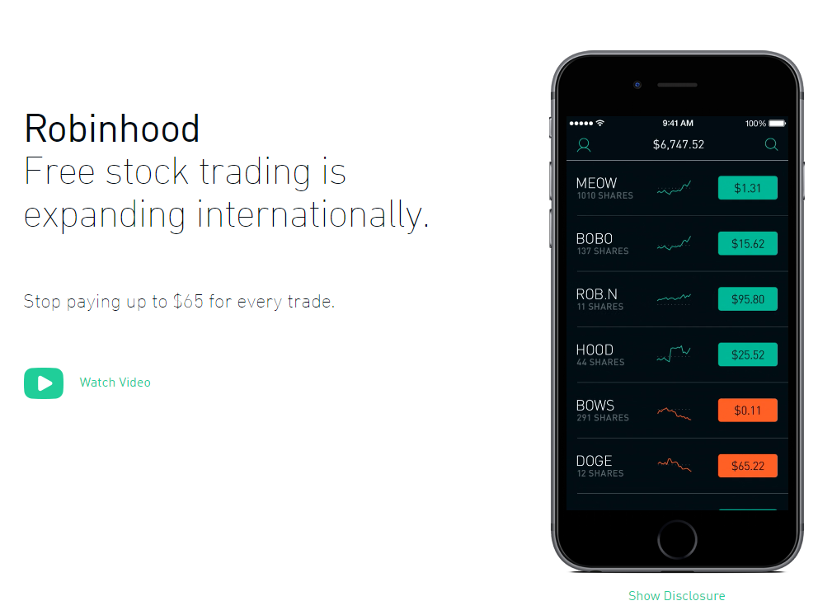
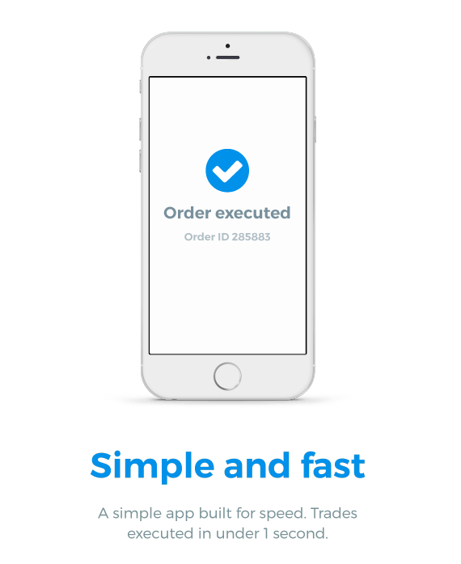
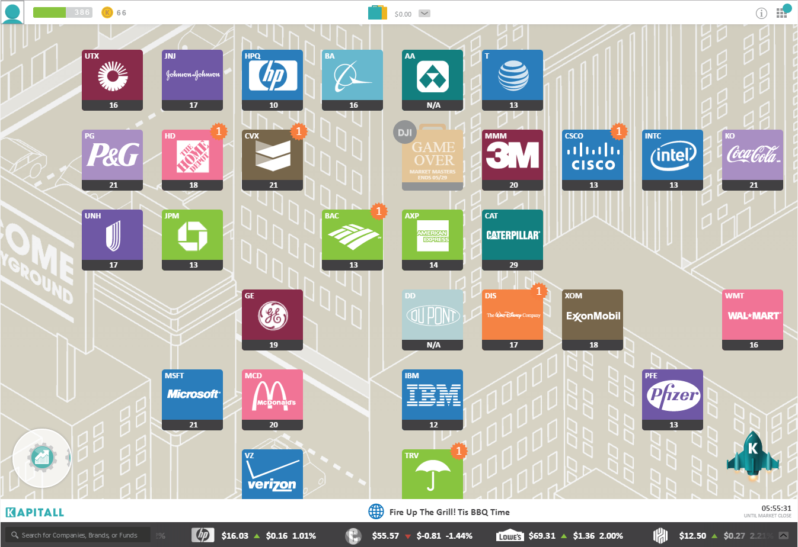
8securities
Robinhood
Kapitall
and many more…

Slide 12
1.
Discovery
2.
Transactions
3.
Portfolio

Slide 13
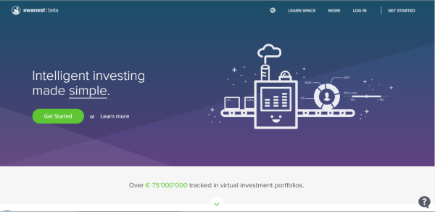
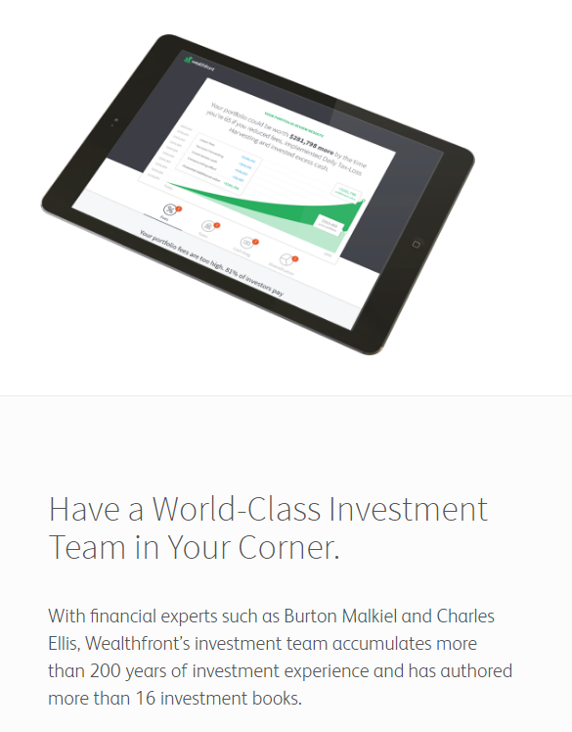
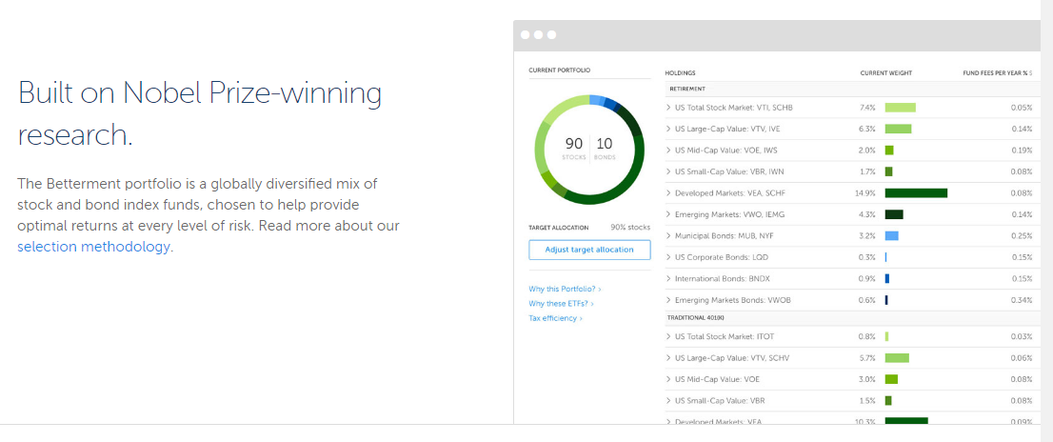
Swanest
Wealthfront
Betterment
and many more…

Slide 14
1.
Discovery
2.
Transactions
3.
Portfolio
4.
Settlement

Slide 15
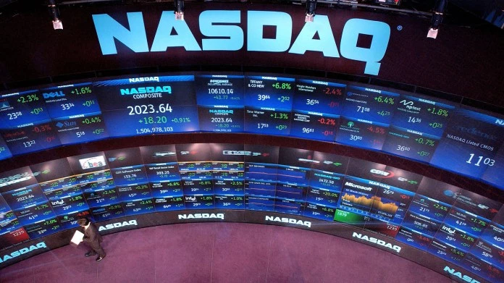
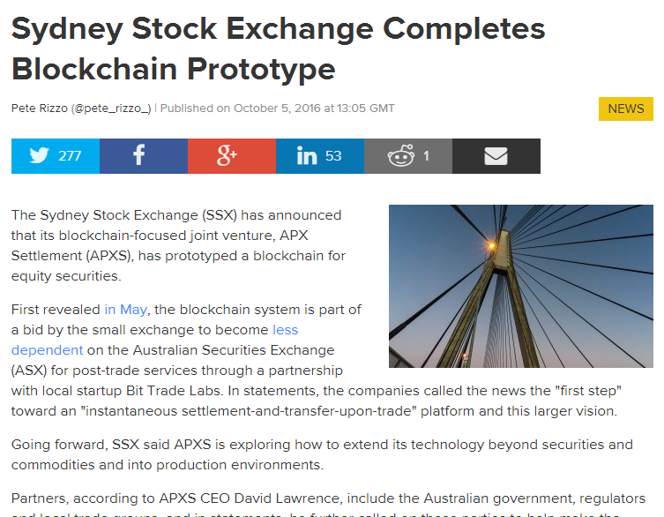
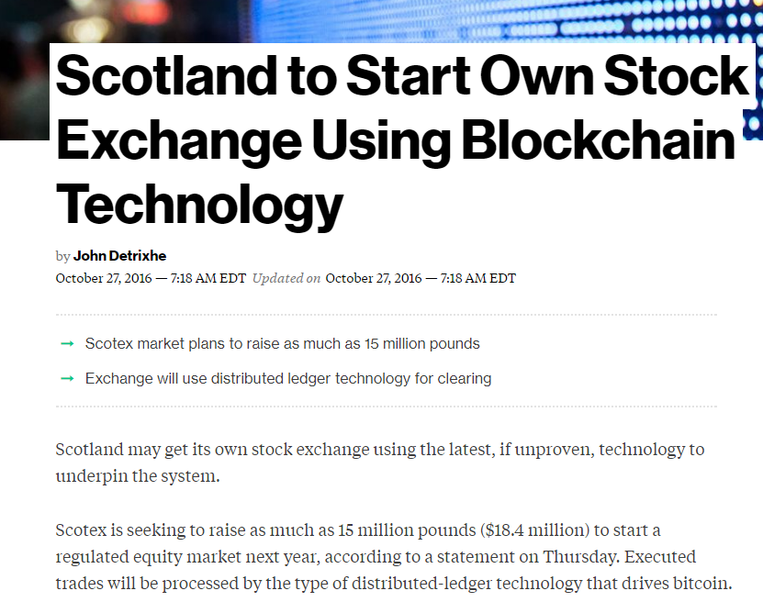
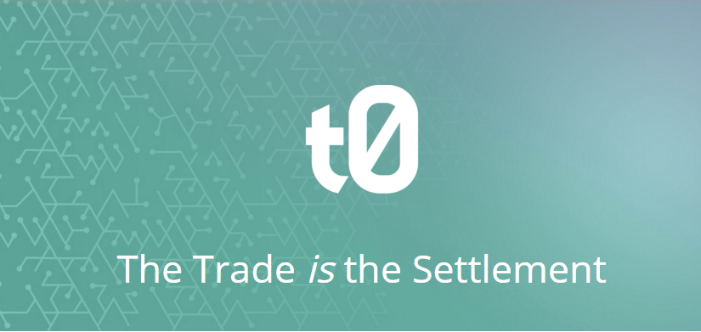
and many more…

Slide 16
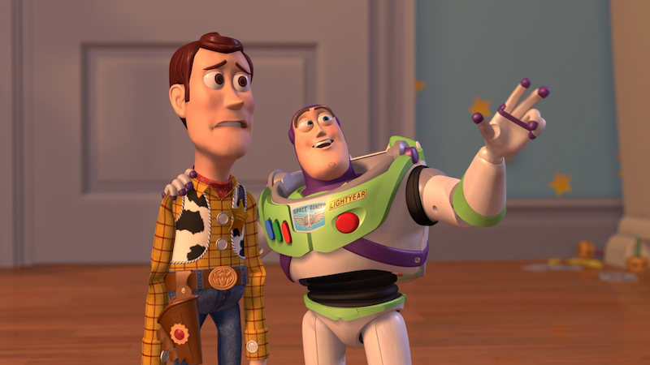
ROBOTS...
ROBOTS EVERYWHERE

Slide 17
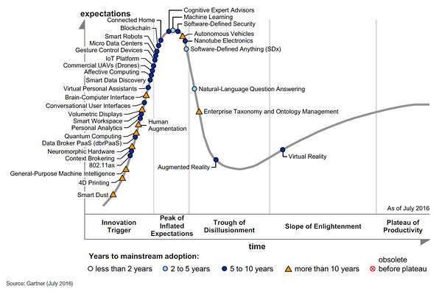
Still long way to go…
Cognitive Expert Advisors(5-10)
Virtual Personal
Assistants (5-10)
Machine learning (2-5)
Natural-Language Question Answering (2-5)
Blockchain (5-10)
Conversional User Interfaces (5-10)

Slide 18
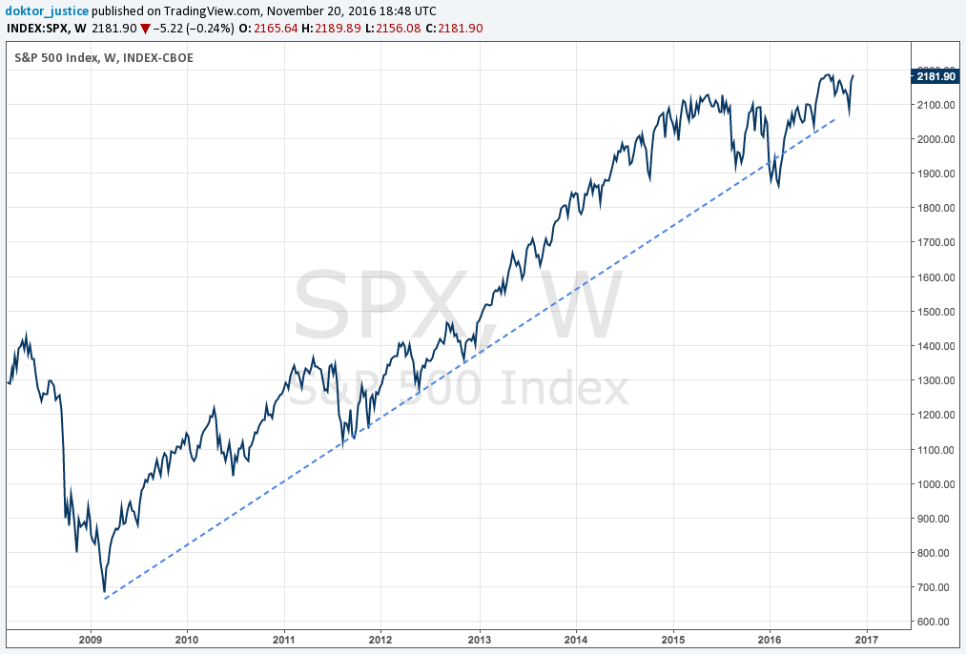
When will it end?

Slide 19
Economy of Scale
Monetization
Regulation
Trust

Slide 20
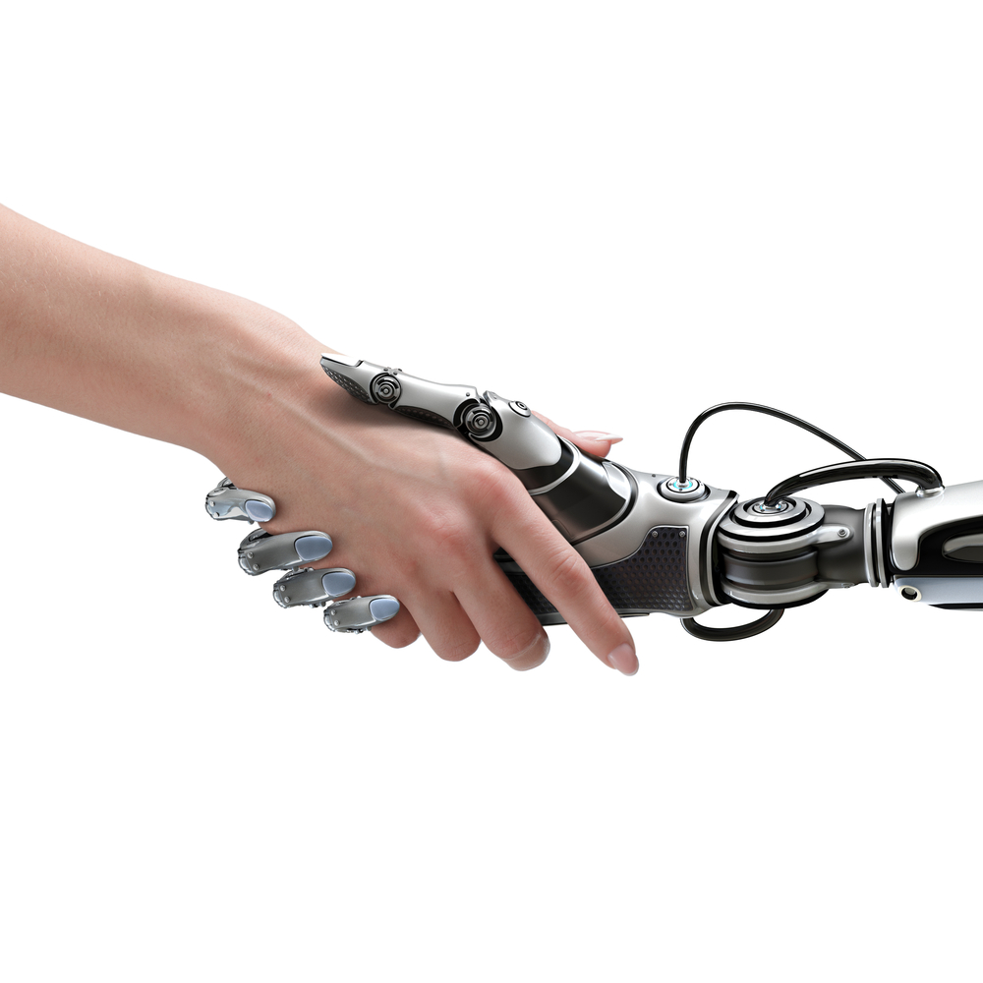
@somiandras

